Slide 1
Example & step-by-step problem solving for k-Medians/k-Medoids & Hierarchical Clustering
-By Team 3

Slide 2
Roadmap
Unsupervised learning
Clustering categories
Clustering algorithms
K-means
Fuzzy c-means
Kernel-based
Graph-based
Q&A

Slide 3
Unsupervised learning
Definition 1
Supervised: human effort involved
Unsupervised: no human effort
Definition 2
Supervised: learning conditional distribution P(Y|X), X: features, Y: classes
Unsupervised: learning distribution P(X), X: features

Slide 4
Clustering
What is clustering?

Slide 5
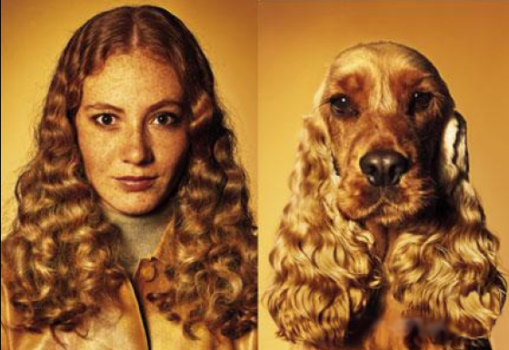
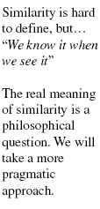
Clustering
Definition
Assignment of a set of observations into subsets so that observations in the same subset are similar in some sense

Slide 6
Clustering
Hard vs. Soft
Hard: same object can only belong to single cluster
Soft: same object can belong to different clusters

Slide 7
Clustering
Hard vs. Soft
Hard: same object can only belong to single cluster
Soft: same object can belong to different clusters
E.g. Gaussian mixture model

Slide 8
Clustering
Flat vs. Hierarchical
Flat: clusters are flat
Hierarchical: clusters form a tree
Agglomerative
Divisive

Slide 9
Hierarchical clustering
Agglomerative (Bottom-up)
Compute all pair-wise pattern-pattern similarity coefficients
Place each of n patterns into a class of its own
Merge the two most similar clusters into one
Replace the two clusters into the new cluster
Re-compute inter-cluster similarity scores w.r.t. the new cluster
Repeat the above step until there are k clusters left (k can be 1)

Slide 10
Hierarchical clustering
Agglomerative (Bottom up)

Slide 11
Hierarchical clustering
Agglomerative (Bottom up)
1st iteration
1

Slide 12
Hierarchical clustering
Agglomerative (Bottom up)
2nd iteration
1
2

Slide 13
Hierarchical clustering
Agglomerative (Bottom up)
3rd iteration
3
1
2

Slide 14
Hierarchical clustering
Agglomerative (Bottom up)
4th iteration
3
1
2
4

Slide 15
Hierarchical clustering
Agglomerative (Bottom up)
5th iteration
3
1
2
5
4

Slide 16
Hierarchical clustering
Agglomerative (Bottom up)
Finally k clusters left
3
9
6
1
2
5
8
4
7

Slide 17
Hierarchical clustering
Divisive (Top-down)
Start at the top with all patterns in one cluster
The cluster is split using a flat clustering algorithm
This procedure is applied recursively until each pattern is in its own singleton cluster

Slide 18
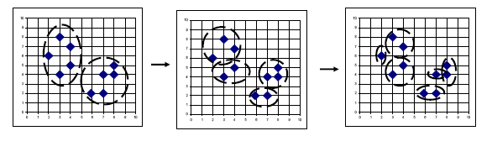
Hierarchical clustering
Divisive (Top-down)

Slide 19
Bottom-up vs. Top-down
Which one is more complex?
Which one is more efficient?
Which one is more accurate?

Slide 20
Bottom-up vs. Top-down
Which one is more complex?
Top-down
Because a flat clustering is needed as a “subroutine”
Which one is more efficient?
Which one is more accurate?

Slide 21
Bottom-up vs. Top-down
Which one is more complex?
Which one is more efficient?
Which one is more accurate?

Slide 22
Bottom-up vs. Top-down
Which one is more complex?
Which one is more efficient?
Top-down
For a fixed number of top levels, using an efficient flat algorithm like K-means, divisive algorithms are linear in the number of patterns and clusters
Agglomerative algorithms are least quadratic
Which one is more accurate?

Slide 23
Bottom-up vs. Top-down
Which one is more complex?
Which one is more efficient?
Which one is more accurate?

Slide 24
Bottom-up vs. Top-down
Which one is more complex?
Which one is more efficient?
Which one is more accurate?
Top-down
Bottom-up methods make clustering decisions based on local patterns without initially taking into account the global distribution. These early decisions cannot be undone.
Top-down clustering benefits from complete information about the global distribution when making top-level partitioning decisions.

Slide 25
K-means
Data set:
Clusters:
Codebook :
Partition matrix:
Minimizes functional:
Iterative algorithm:
Initialize the codebook V with vectors randomly picked from X
Assign each pattern to the nearest cluster
Recalculate partition matrix
Repeat the above two steps until convergence

Slide 26
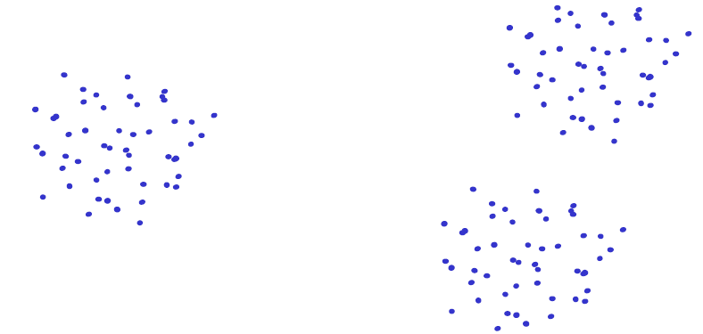
K-means
Disadvantages
Dependent on initialization

Slide 27
K-means
Disadvantages
Dependent on initialization

Slide 28
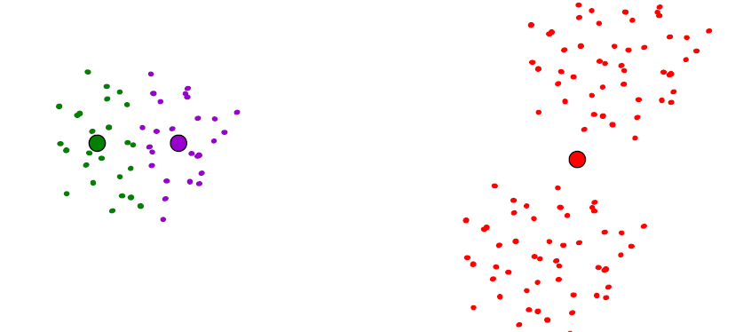
K-means
Disadvantages
Dependent on initialization

Slide 29
K-means
Disadvantages
Dependent on initialization
Select random seeds with at least D_{min}
Or, run the algorithm many times

Slide 30
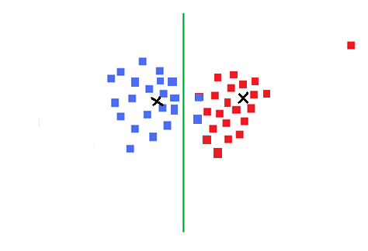
K-means
Disadvantages
Dependent on initialization
Sensitive to outliers

Slide 31
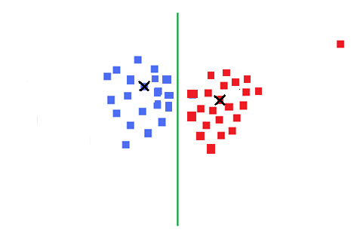
K-means
Disadvantages
Dependent on initialization
Sensitive to outliers
Use K-medoids
Notes:
Add definition of median

Slide 32
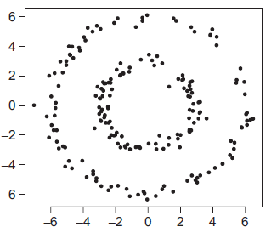
K-means
Disadvantages
Dependent on initialization
Sensitive to outliers (K-medoids)
Can deal only with clusters with spherical symmetrical point distribution
Kernel trick

Slide 33
K-means
Disadvantages
Dependent on initialization
Sensitive to outliers (K-medoids)
Can deal only with clusters with spherical symmetrical point distribution
Deciding K

Slide 34
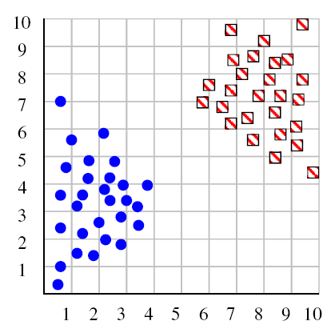
Deciding K
Try a couple of K

Slide 35
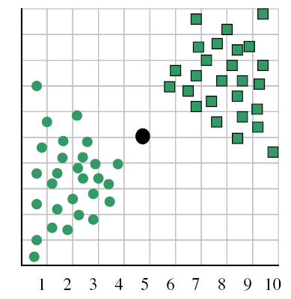
Deciding K
When k = 1, the objective function is 873.0

Slide 36
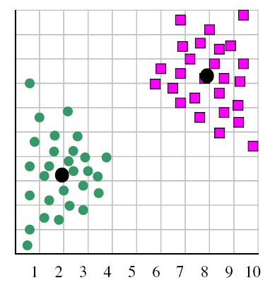
Deciding K
When k = 2, the objective function is 173.1

Slide 37
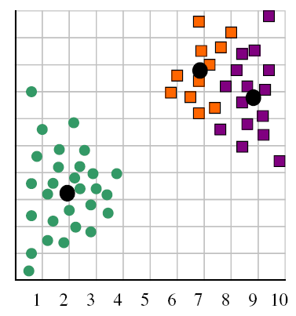
Deciding K
When k = 3, the objective function is 133.6

Slide 38
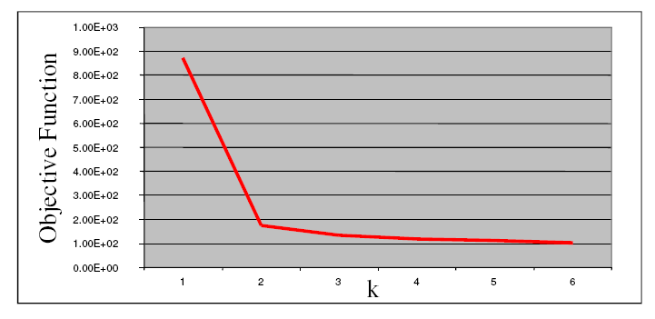
Deciding K
We can plot objective function values for k=1 to 6
The abrupt change at k=2 is highly suggestive of two clusters
“knee finding” or “elbow finding”
Note that the results are not always as clear cut as in this toy example

Slide 39
EM – Expectation Maximization
The EM algorithm is used to find (locally) maximum likelihood parameters of a statistical model in cases where the equations cannot be solved directly. Typically these models involve latent variables in addition to unknown parameters and known data observations. That is, either there are missing values among the data, or the model can be formulated more simply by assuming the existence of additional unobserved data points. For example, a mixture model can be described more simply by assuming that each observed data point has a corresponding unobserved data point, or latent variable, specifying the mixture component that each data point belongs to.

Slide 40
The EM algorithm proceeds from the observation that the following is a way to solve these two sets of equations numerically. One can simply pick arbitrary values for one of the two sets of unknowns, use them to estimate the second set, then use these new values to find a better estimate of the first set, and then keep alternating between the two until the resulting values both converge to fixed points. It's not obvious that this will work at all, but in fact it can be proven that in this particular context it does, and that the derivative of the likelihood is (arbitrarily close to) zero at that point, which in turn means that the point is either a maximum or a saddle point.^{[12]} In general there may be multiple maxima, and there is no guarantee that the global maximum will be found. Some likelihoods also have singularities in them, i.e. nonsensical maxima. For example, one of the "solutions" that may be found by EM in a mixture model involves setting one of the components to have zero variance and the mean parameter for the same component to be equal to one of the data points.

Slide 41
Finding a maximum likelihood solution typically requires taking the derivatives of the likelihood function with respect to all the unknown values — viz. the parameters and the latent variables — and simultaneously solving the resulting equations. In statistical models with latent variables, this usually is not possible. Instead, the result is typically a set of interlocking equations in which the solution to the parameters requires the values of the latent variables and vice versa, but substituting one set of equations into the other produces an unsolvable equation.

Slide 42
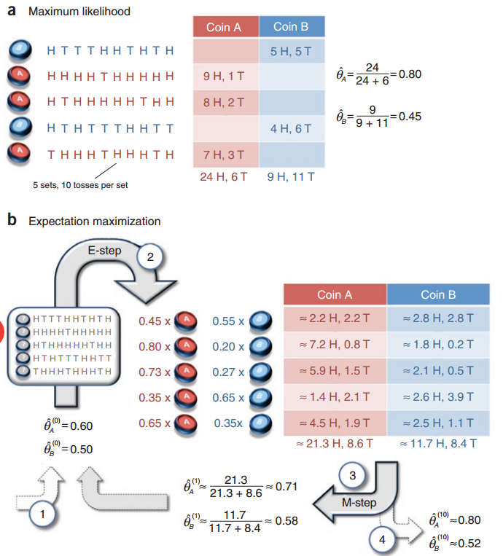
EM - Example

Slide 43
References
https://www.google.com/url?sa=t&rct=j&q=&esrc=s&source=web&cd=3&cad=rja&uact=8&ved=0ahUKEwjPh_62taDLAhUFuoMKHWi_BiIQFgglMAI&url=http%3A%2F%2Fwww.cs.unc.edu%2F~lazebnik%2Ffall09%2Fclustering_techniques_and_applications.pptx&usg=AFQjCNHUPHu4OlH4yY2ZRQeqfWxVv7eTvA&sig2=Bvi83S_TlUnXRkdi1IthvA&bvm=bv.115339255,d.amc
https://en.wikipedia.org/wiki/Expectation%E2%80%93maximization_algorithm
http://ai.stanford.edu/~chuongdo/papers/em_tutorial.pdf

